Slide 1


An Attention-Based CNN-Transformer Network for ECG Beat Classification Using Multi-Lead Signals
VR SIDDHARTHA ENGINEERING COLLEGE
Department of Information Technology
B.Tech in Information Technology
Major Project Review Presentation
Presented by
Ms. Kavya Sri Pasupuleti (228W1A12H9)
Ms. Supraja Potluri (228W1A12I3)
Under the guidance of
Dr. C. S. Pavan Kumar, Sr. Asst. Professor

Slide 2
Agenda
Motivation
Problem Statement
Objectives and Outcomes of the Project
Literature Summary
Datasets and Requirements
Methadology and Algorithms Involved
Architecture Diagram
Complete Results Obtained
Result Analysis & Observations
References

Slide 3
Introduction
Cardiovascular diseases are one of the leading causes of death worldwide.
ECG is one of the most widely used tools for detecting heart abnormalities.
Manual ECG interpretation is time-consuming and depends heavily on expert knowledge.
An automated ECG classification system can support faster and more reliable diagnosis.

Slide 4
Problem Statement
Manual ECG interpretation is time-consuming, requires expert knowledge, and may lead to human errors.
Existing automated methods rely on handcrafted features or single-lead ECG, limiting accuracy.
Difficulty in capturing both local waveform patterns and long-range temporal dependencies in ECG signals.
Need for an efficient automated system that accurately classifies multi-lead ECG signals using advanced deep learning techniques.

Slide 5
Objectives and Outcomes
Objectives:
To use multi-lead ECG signals for better diagnostic representation.
To perform R-peak detection and beat segmentation from raw ECG data.
To classify ECG beats into CD, HYP, MI, NORM, and STTC classes.
To improve classification performance using CNN + Transformer + Attention.
Outcomes:
Successfully extracted beat-level ECG samples from PTB-XL dataset.
Developed a deep learning model for multi-class ECG classification.
Achieved 97.06% test accuracy.
Generated performance metrics and visual result analysis.

Slide 6
Literature Summary
S.NO | Paper & Author name | Year of publication | Algorithms | Workdone | Conclusion
1 | Interpreting Deep Neural Networks for Single-Lead ECG Arrhythmia Classification Vijayarangan, S. et al. | 2020 | Deep Neural Networks (DNN) CNN-based models Model interpretation techniques (like saliency/attention visualization) | The authors created a deep learning-based architecture for arrhythmia classification based on single-lead ECG records. The work mainly emphasized not only obtaining good results in classification but also making deep neural networks more interpretable. Convolutional neural network algorithms were utilized to obtain relevant features from ECG data, while the interpretation of the model was done using visualization approaches to determine which sections of the input signal influenced the model’s decision the most. | According to the researchers’ findings, deep neural networks prove to be highly efficient when performing arrhythmia classification based on single-lead ECG records. Moreover, applying interpretability approaches makes the use of deep neural networks more reliable in the clinical setting.
2 | A Hybrid Deep Learning Approach for ECG-Based Arrhythmia Classification Madan, P. et al. | 2022 | Hybrid Deep Learning: CNN (for feature extraction) RNN / LSTM (for temporal dependencies) | The authors suggested a hybrid deep learning model based on convolutional neural networks (CNN) and long short-term memory (LSTM) networks to classify arrhythmia during ECG. Spatial features of ECG signals were automatically selected using CNN, and the temporal dependencies of the sequence were learned with LSTM. This model was trained and tested on ECG datasets to classify various types of arrhythmias, which reveals the benefits of using feature extraction and sequence modeling methods. | The researchers came to the conclusion that hybrid deep learning techniques are much effective in terms of classification performance in comparison with single models. CNN and LSTM are effective in the combination of their ability to capture the spatial and temporal features of the ECG signals resulting in increased accuracy and strength. This method is especially applicable to time-series medical data such as ECG.

Slide 7
S.NO | Paper & Author name | Year of publication | Algorithms | Workdone | Conclusion
3 | Arrhythmia Detection in Inter-Patient ECG Signals Using Entropy Rate Features and RR Intervals with CNN Architecture Berrahou, N. et al. | 2024 | CNN (Convolutional Neural Network) Feature Engineering: Entropy rate features RR interval features | This paper is concentrated on detecting the arrhythmia with inter-patient ECG signals with a combination of handcrafted features and deep learning. The authors used entropy-based features and RR interval features to capture variability and complexity of heart rhythms. These attributes were then inputted into a convolutional neural network (CNN) to be classified. The paper had a focus on the management of inter-patient variability so that the model can be effective on various individuals. | The authors found that the combination of handcrafted attributes like entropy and RR intervals with CNN enhances classification and generalization between patients. The model showed good results in the way it managed differences among various individuals, and it is more applicable to real-world clinical practice.
4 | A Historical Survey of Advances in Transformer Architectures Sajun, A.R. et al. | 2024 | Transformer Architecture Self-Attention Mechanism Variants of Transformers | The authors had an elaborate survey of the development of Transformer architectures, their development and their usage in sequence modeling tasks. The article provided the mechanism of self-attention and how Transformers can reach the shortcomings of the more traditional sequence models, such as RNNs. It also discussed different variants of Transformers and their implementation in other fields, such as in healthcare and time-series data analysis. | This paper has found that Transformer architectures are well suited to prediction of sequential data because they can address long range dependencies with self-attention based mechanisms. They perform better than traditional models in a wide range of sequence-based tasks, and are also finding more and more uses in medical signal processing applications, including ECG analysis.
5 | ECG Signal Classification Review Fikri, M.R. et al. | 2021 | Machine Learning (SVM, KNN) Deep Learning (CNN, RNN) | The paper has introduced an in-depth survey of the ECG signal classification algorithms, including the classical machine learning algorithms and the latest deep learning algorithms. The authors examined different algorithms including support vector machines, k-nearest neighbors, convolutional neural networks and recurrent neural networks. They have also addressed various preprocessing, datasets and evaluation methods of the ECG classification studies. | The review showed that the deep learning techniques, especially CNN and RNN-based models are better at ECGs classification tasks than conventional machine learning techniques. Nevertheless, there are still challenges like data quality, computational complexity, and implementation requirements that are required to be real-time. The research has emphasized the need to come up with more effective and precise models that can be used in the clinical context.

Slide 8
Datasets and Requirements
Datasets:
PTB-XL ECG Dataset:
A large dataset with 21,000+ ECG records from 18,000 patients.
Contains 12-lead ECG signals labeled with multiple heart conditions.
Requirements:
Hardware Requirements:
Minimum 8 GB RAM
GPU with ≥ 8 GB VRAM

Slide 9
Software Tools:
Python 3.9 -Programming language
PyTorch & PyTorch Geometric - CNN model implementation & training
NumPy & Pandas - Data handling & processing
Matplotlib & Seaborn – Visualization
Scikit-learn - Model evaluation & metrics
Google Colab / Kaggle Notebook - Development environment

Slide 10
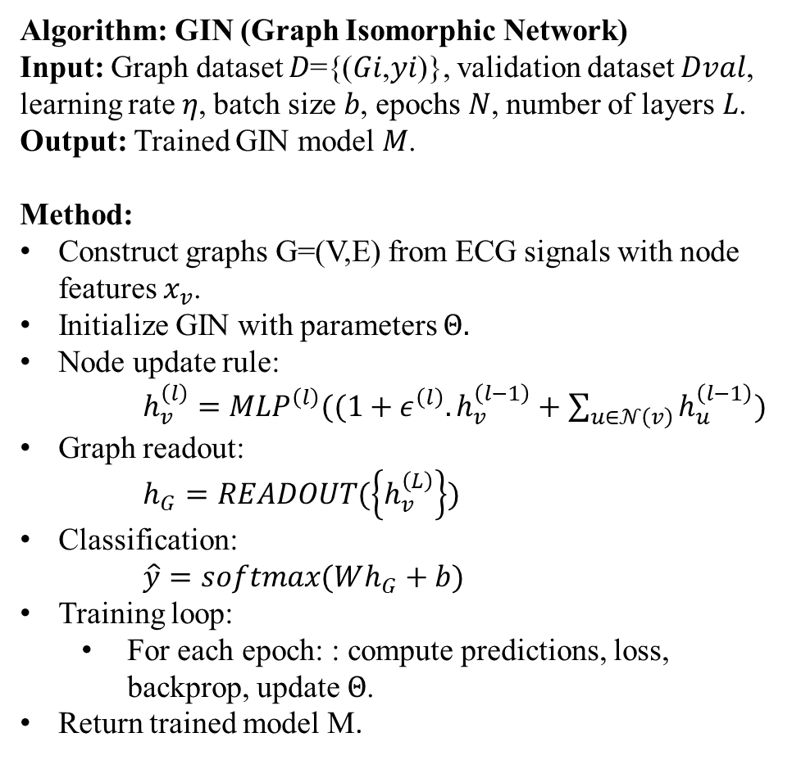
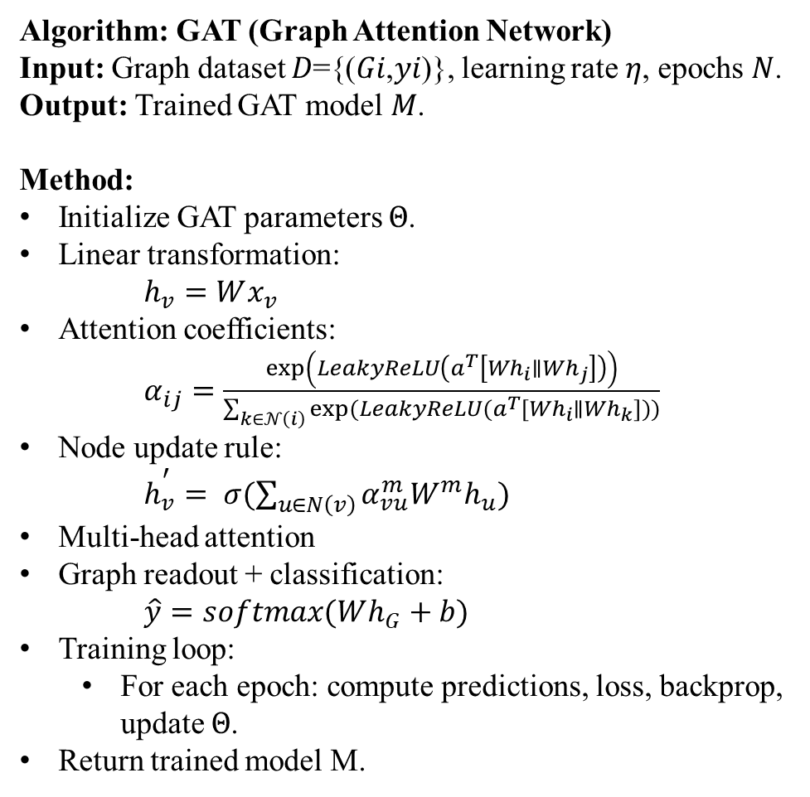
Algorithms Involved
Algorithm: GIN (Graph Isomorphic Network)
Input: Graph dataset 𝐷={(𝐺𝑖,𝑦𝑖)}, validation dataset 𝐷𝑣𝑎𝑙, learning rate 𝜂, batch size 𝑏, epochs 𝑁, number of layers 𝐿.
Output: Trained GIN model 𝑀.
Method:
Construct graphs G=(V,E) from ECG signals with node features $x_{v}$​.
Initialize GIN with parameters $Θ.$
Node update rule:
$h_{v}^{\left(l\right)}={MLP}^{\left(l\right)}((1+ε^{\left(l\right)}.h_{v}^{\left(l−1\right)}+\sum_{u∈𝒩\left(v\right)}{h_{u}^{\left(l−1\right)})}$
Graph readout:
$h_{G}=READOUT(\left\{h_{v}^{\left(L\right)}\right\})$
Classification:
$\hat{y}=softmax(Wh_{G}+b)$
Training loop:
For each epoch: : compute predictions, loss, backprop, update $Θ$.
Return trained model M.
Algorithm: GAT (Graph Attention Network)
Input: Graph dataset 𝐷={(𝐺𝑖,𝑦𝑖)}, learning rate 𝜂, epochs 𝑁.
Output: Trained GAT model 𝑀.
Method:
Initialize GAT parameters $Θ$.
Linear transformation:
$h_{v}=Wx_{v}$
Attention coefficients:
$α_{ij}=\frac{\exp\left(LeakyReLU\left(a^{T}\left[Wh_{i}∥Wh_{j}\right]\right)\right)}{\sum_{k∈𝒩\left(i\right)}{exp(LeakyReLU(}a^{T}[Wh_{i}∥Wh_{k}]))}$
Node update rule:
$h_{v}^{\text{′​}}= σ(\sum_{u∈N\left(v\right)}{​α_{vu}^{m}W^{m}h_{u})}$
Multi-head attention
Graph readout + classification:
$\hat{y}=softmax(Wh_{G}+b)$
Training loop:
For each epoch: compute predictions, loss, backprop, update $Θ$.
Return trained model M.

Slide 11
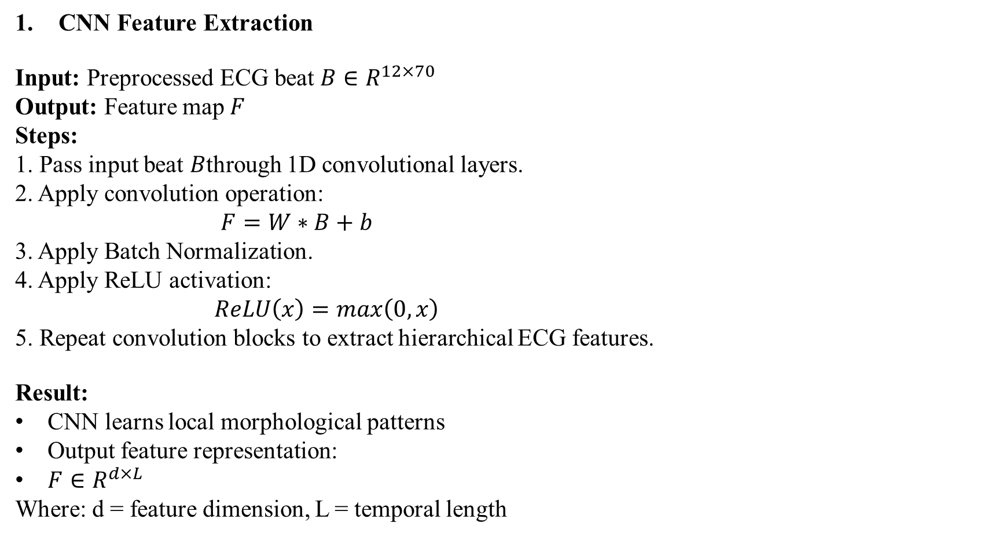
Algorithms Involved
CNN Feature Extraction
Input: Preprocessed ECG beat $B∈R^{12×70}$
Output: Feature map 𝐹
Steps:
1. Pass input beat 𝐵through 1D convolutional layers.
2. Apply convolution operation:
$F=W∗B+b$
3. Apply Batch Normalization.
4. Apply ReLU activation:
$ReLU\left(x\right)=max\left(0,x\right)$
5. Repeat convolution blocks to extract hierarchical ECG features.
Result:
CNN learns local morphological patterns
Output feature representation:
$F∈R^{d×L}$
Where: d = feature dimension, L = temporal length

Slide 12
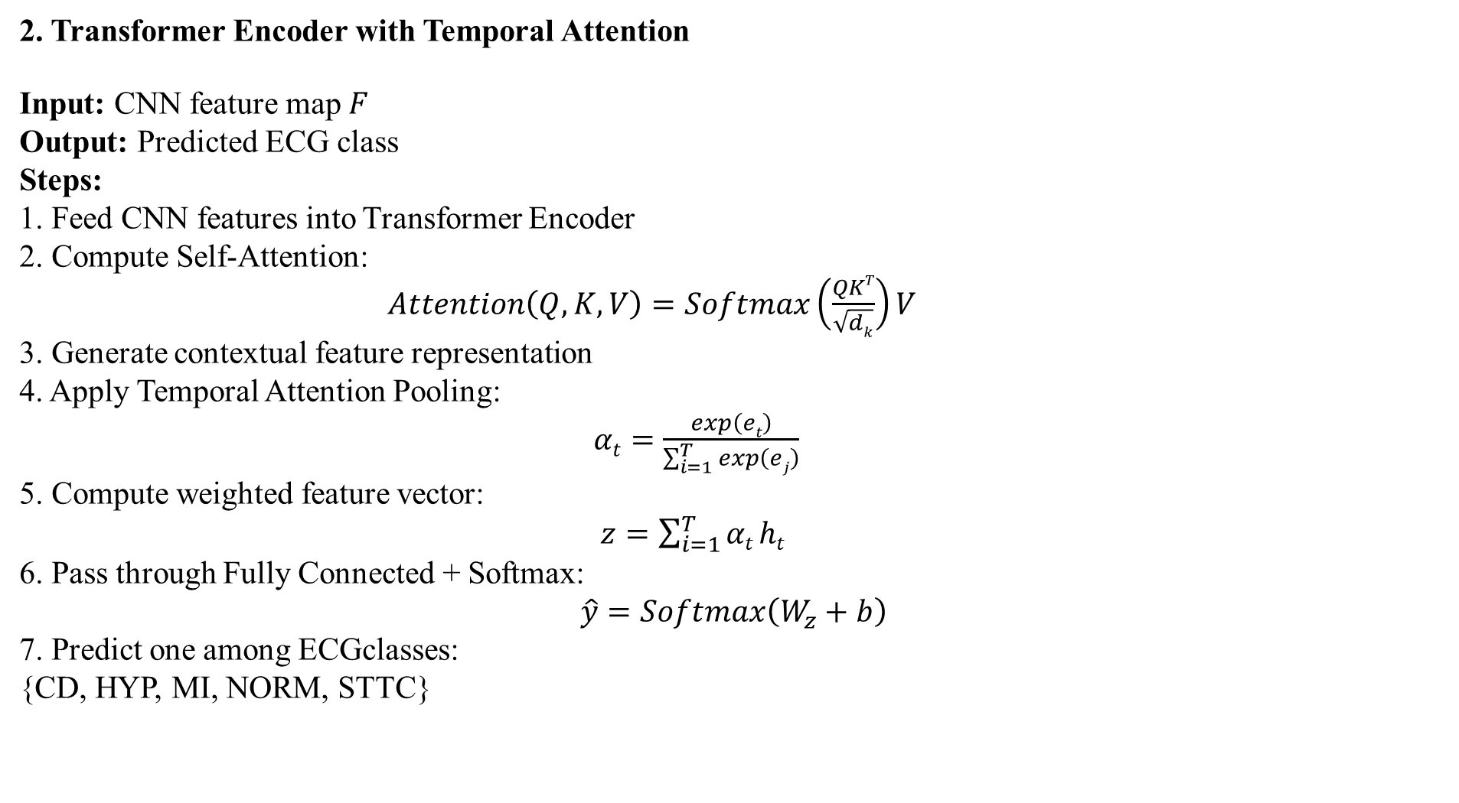
2. Transformer Encoder with Temporal Attention
Input: CNN feature map 𝐹
Output: Predicted ECG class
Steps:
1. Feed CNN features into Transformer Encoder
2. Compute Self-Attention:
$Attention\left(Q,K,V\right)=Softmax\left(\frac{QKT}{\sqrt{dk}}\right)V$
3. Generate contextual feature representation
4. Apply Temporal Attention Pooling:
$αt=\frac{exp\left(et\right)}{\sum_{i=1}^{T}{exp\left(ej\right)}}$
5. Compute weighted feature vector:
$z=\sum_{i=1}^{T}{αt}ht$
6. Pass through Fully Connected + Softmax:
$$\hat{y}=Softmax\left(W_{z}+b\right)$$
7. Predict one among ECGclasses:
{CD, HYP, MI, NORM, STTC}

Slide 13
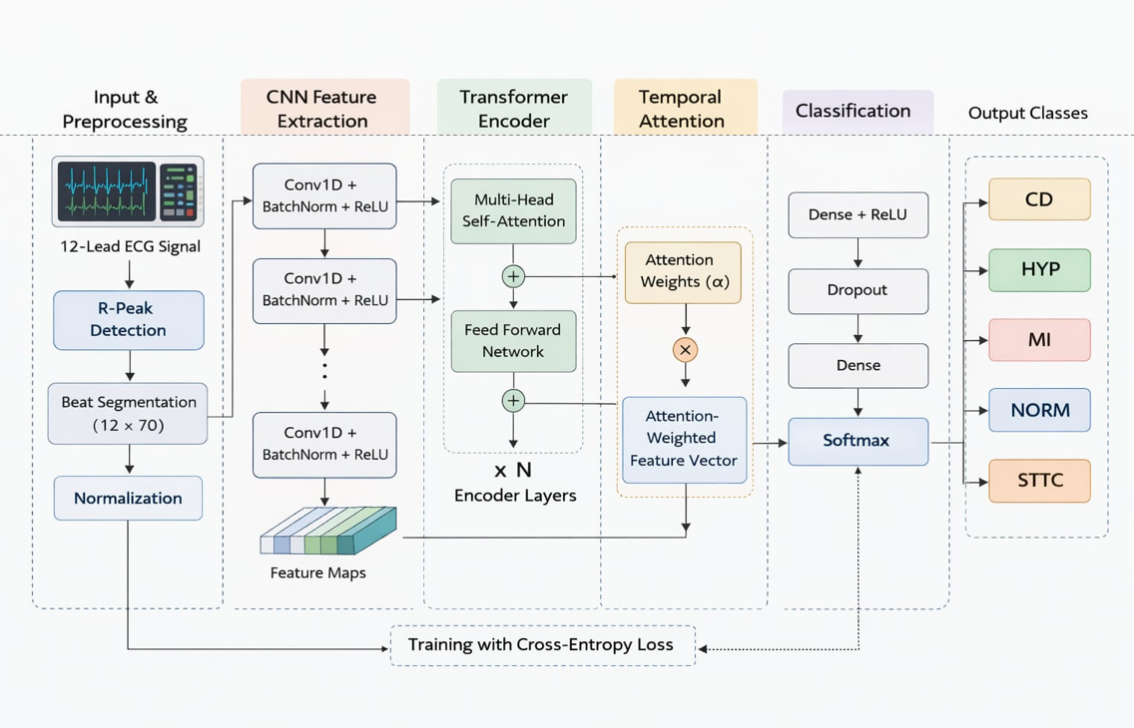
Architecture Diagram

Slide 14
Implementation steps and Execution
Implementation steps:
1. Load multi-lead ECG signals from PTB-XL dataset
2. Perform R-peak detection to locate heartbeats
3. Segment ECG into individual beats
4. Normalize segmented ECG beats
5. Split dataset into training, validation, testing sets
6. Design CNN - Transformer - Attention architecture
7. Train the model using training data
8.Evaluate model using performance metrics

Slide 15
Execution:
1. Initialize environment using Python and PyTorch (Colab/Kaggle)
2. Load ECG data and corresponding labels
3. Apply preprocessing (R-peak detection, segmentation, normalization)
4. Convert data into model input format
5. Initialize CNN–Transformer–Attention model
6. Train model over multiple epochs
7. Test model on unseen ECG samples
8. Generate predictions and evaluate results

Slide 16
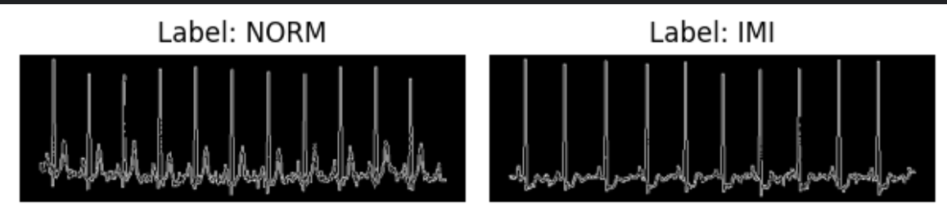
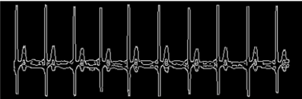
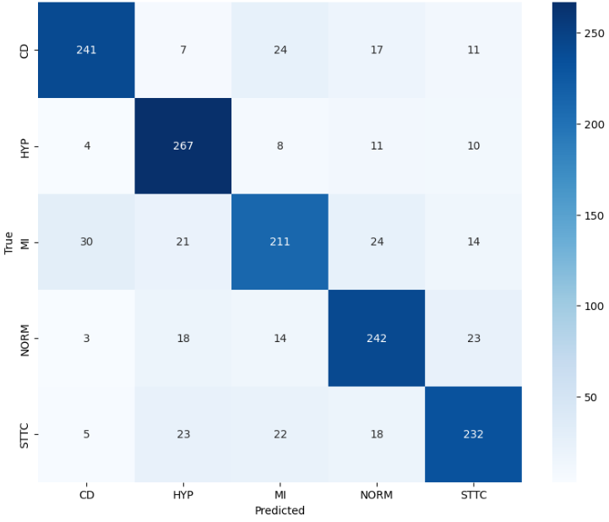
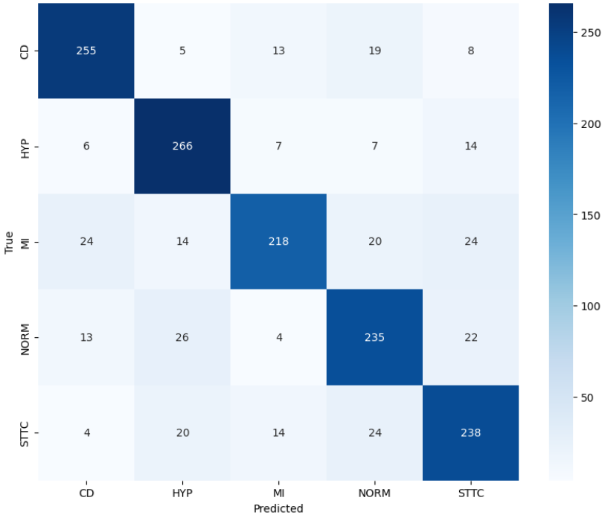
Result Obtained
Norm after pre-processing
MI after pre-processing
Confusion matrix of GIN
Confusion matrix of GAT

Slide 17
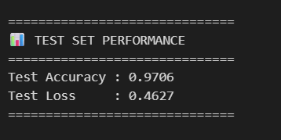
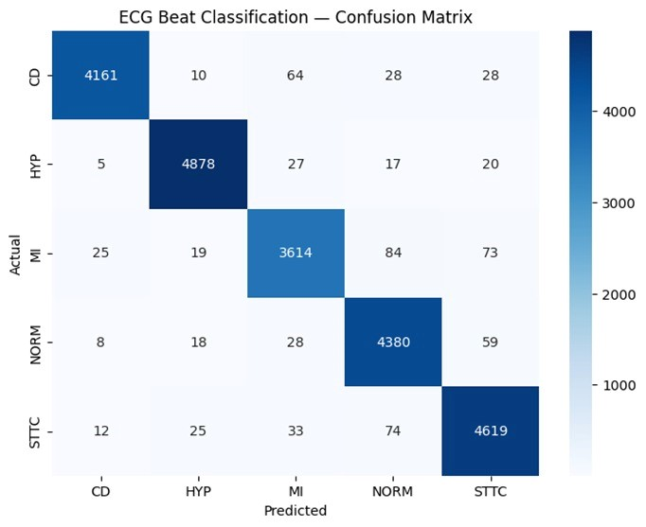
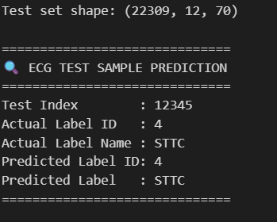

Slide 18
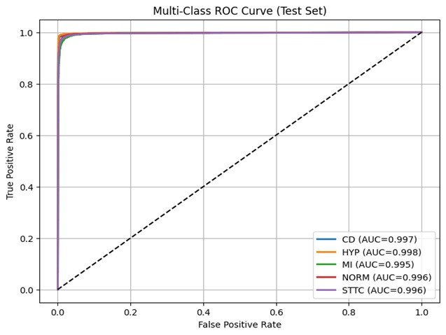
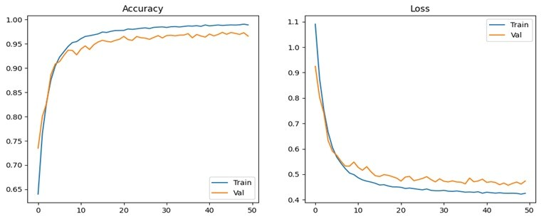
Result Analysis & Observations
The proposed model achieved a test accuracy of 97.06%, indicating strong performance in classifying ECG beats into five diagnostic categories.
The training and validation accuracy curves show stable learning, while the loss curves decrease consistently, indicating effective convergence.
The confusion matrix shows that most predictions are correctly classified along the diagonal, with only a few misclassifications between similar ECG classes.
The ROC curves and high AUC values confirm that the model has excellent class discrimination capability.
Overall, the combination of CNN, Transformer Encoder, and Temporal Attention helps the model capture both local waveform features and long-range temporal dependencies effectively.

Slide 19
Conclusion and Future work
The proposed model effectively classifies ECG signals using a hybrid approach combining CNN, Transformer Encoder, and Attention.
It achieves high accuracy by capturing both local waveform features and long-range temporal dependencies.
The use of multi-lead ECG data improves diagnostic performance and classification reliability.
The system can be extended to real-time ECG monitoring using wearable and IoT-based healthcare devices.
Future improvements include optimizing the model for deployment on mobile or edge devices with reduced computational cost.
Further research can focus on incorporating explainable AI and expanding the model to detect additional cardiac conditions.

Slide 20
References
[1] S. Vijayarangan, B. Murugesan, R. Vignesh, S. Preejith, J. Joseph, and M. Sivaprakasam, “Interpreting Deep Neural Networks for Single-Lead ECG Arrhythmia Classification.,” Annual International Conference of the IEEE Engineering in Medicine and Biology Society. IEEE Engineering in Medicine and Biology Society. Annual International Conference, vol. 2020, pp. 300–303, Jul. 2020.
[2] P. Madan, V. Singh, D.P. Singh, M. Diwakar, B. Pant, A. Kishor, “A Hybrid Deep Learning Approach for ECG-Based Arrhythmia Classification,” Bioengineering (Basel, Switzerland), vol. 9, p. 152, 2022.
[3] N. Berrahou, A. El Alami, A. Mesbah, R. El Alami, A. Berrahou, “Arrhythmia Detection in Inter-Patient ECG Signals Using Entropy Rate Features and RR Intervals with CNN Architecture,” Computer Methods in Biomechanics and Biomedical Engineering, ahead-of-print, pp. 1–20, 2024.
[4] M.R. Fikri, I. Soesanti, H.A. Nugroho, “ECG Signal Classification Review,” International Journal of Information Technology and Electrical Engineering (IJITEE), vol. 5, p. 15, 2021.

Slide 21
[5] A.R. Sajun, I. Zualkernan, D. Sankalpa, “A Historical Survey of Advances in Transformer Architectures,” Applied Sciences, vol. 14, p. 4316, 2024.
[6] S.R. Choi, M. Lee, “Transformer Architecture and Attention Mechanisms in Genome Data Analysis: A Comprehensive Review,” Biology, vol. 12, p. 1033, 2023.
[7] H. Mansour, M. Valizadeh, A. Abdulaal, M. Amirani, “Enhanced Electrocardiogram Arrhythmia Diagnosis with Deep Learning and Selective Attention Mechanism,” Advances in Technology Innovation, vol. 10, pp. 102–117, 2025.
[8] A. Natarajan, Y. Chang, S. Mariani, A. Rahman, G. Boverman, S. Vij, J. Rubin, “A Wide and Deep Transformer Neural Network for 12-Lead ECG Classification,” Presented at Computing in Cardiology Conference (CinC), Dec. 30, 2020.

